Slide 1



Saksham
AI Powered communication solution for disabled
Mentored By-
Bikram Pratim Bhuyan
Presented By-
Utkarsh Gupta
Aradhya Singh
Priyal Gupta
R177219194 500075374
R177219206 500075358
R177219136 500076110

Slide 2



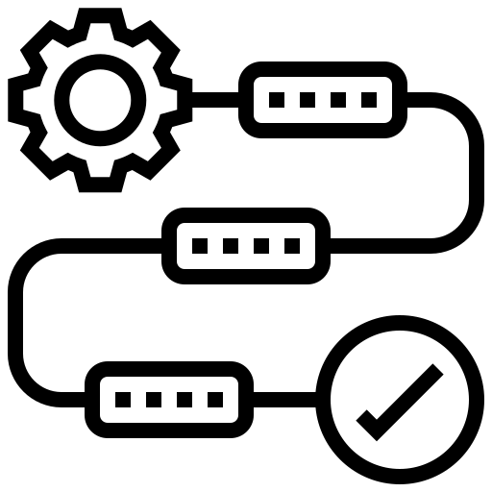





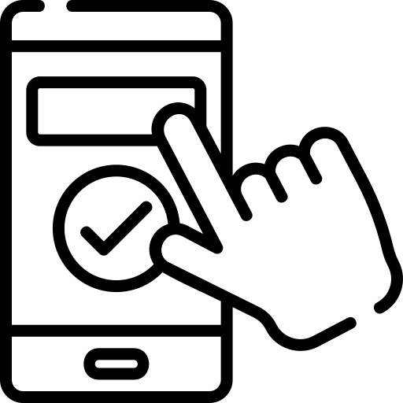

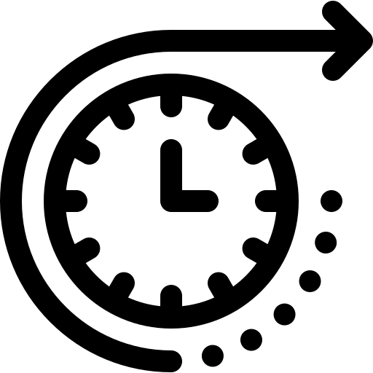




Contents
Introduction
Literature Review
Objective
Methodology
Project Architecture
Challenges
Server
Front end
Hardware
Use Cases
Project Status
Future Aspects
Achievements
References
Team Details

Slide 3
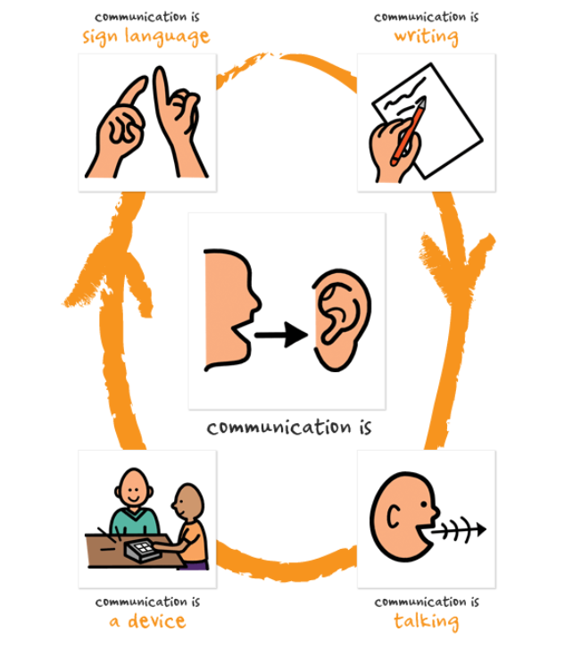
Introduction
Single point solution for communication gap between blind, deaf, mute and normal population. Application is able to convert sign language, voice, braille & text to each other which enables almost everyone to be able to communicate with anyone. The sign language recognition will be achieved through computer vision, voice recognition will be achieved by DNN, braille will be achieved by a sophisticated wireless hardware.

Slide 4
Literature Review
Sign Language to Text and Speech Translation in Real Time Using Convolutional Neural Network
DRISHYAM: Real-Time Text to Braille Conversion and Realization
Efficient Kinect Sensor-based Kurdish Sign Language Recognition Using Echo System Network
Grad-TTS: A Diffusion Probabilistic Model for Text-to-Speech
AN ADVANCED BRAILLE SYSTEM-COMMUNICATION DEVICE FOR BLIND-DEAF PEOPLE
VOICE RECOGNITION SYSTEM: SPEECH-TO-TEXT

Slide 5
Objective
To develop remote communication software accessible to normal, blind, dumb and deaf people, and construct hardware i.e., an interactive, wireless refreshable Braille device that would be connected to the software to facilitate communication for blind people.

Slide 6
Methodology
Developing AI models
Development of user interface
1. Text to Speech 2. Speech to Text 3. Sign Language to Text
Construction of Hardware
Setting up the server
1. Braille to Text 2. Text to Braille

Slide 7
Project Architecture
Server
PC (Front End)
PC (Front End)
Hardware
Hardware

Slide 8
The Impossible
Sign Language to Voice
Voice to Braille
Braille to Voice
Sign Language to Braille
No one has tried such objectives, Hence no papers and prior work for reference.
No such datasets exists. Constructing such dataset would take months.
The neural networks would be extremely complex to be run on a PC.

Slide 9
Achieving “The Impossible”
Introduction of a middle layer.
All the communication methods will first convert to the middle layer.
The middle layer will then pass on to the other communication method.
We figured out the middle layer should be “text”.
Sign Language
Text
Sign Language
Braille
Braille
Voice
Voice

Slide 10
Server
Roles
Components
Technological Stack
Receive Messages from front end.
Forward Messages to front-end.
Convert Sign Language to text.
Restful API.
Sign Language to text model.
Python.
Flask.
TensorFlow.

Slide 11
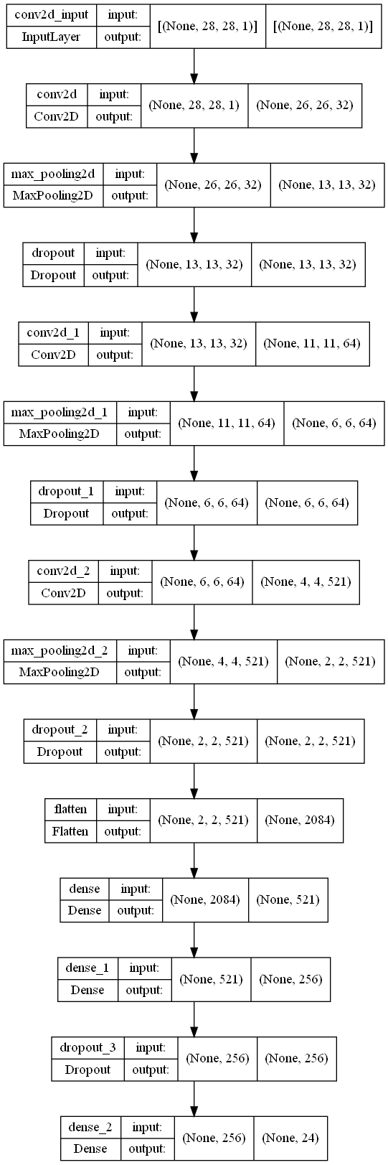
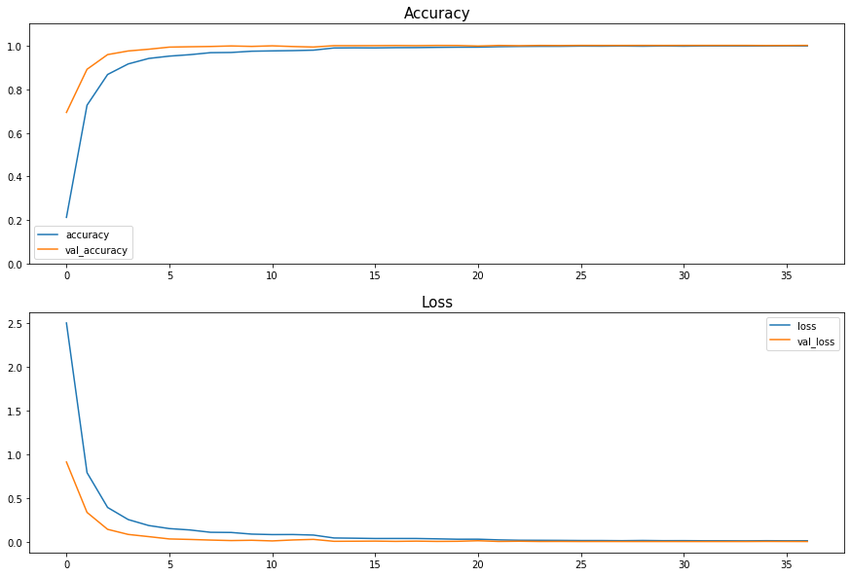
Sign Language Recognition Model

Slide 12
Front End
Roles
Components
Technological Stack
Receive messages from Server.
Send messages to Server.
Receive messages from hardware.
Send messages to hardware.
Show messages.
Take text/voice/image/braille input from the user.
Web application.
Text to speech module.
Speech to text module.
Serial Communication module.
HTML/CSS/JavaScript
ReactJS
Google voice to text API.

Slide 13
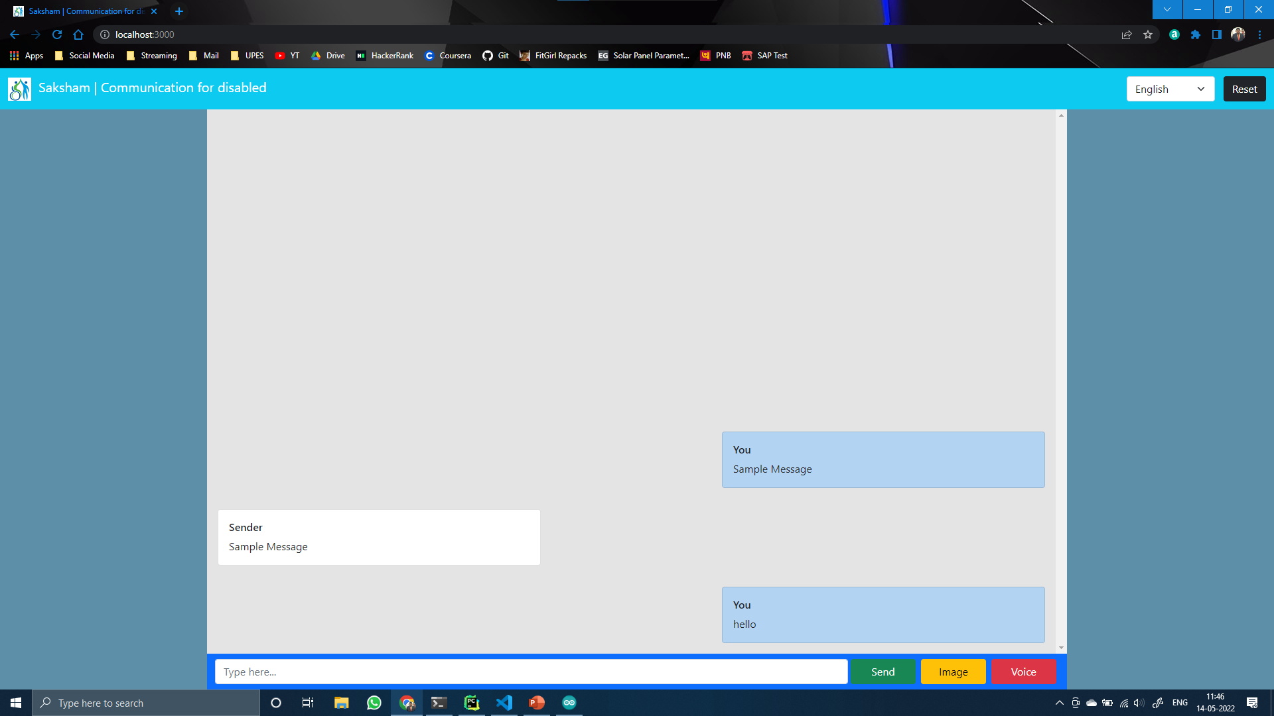
Minimalist design.
Easy to use.
Responsive for different screen sizes.

Slide 14
Hardware
Roles
Components
Technological Stack
Receive messages from Front end.
Send messages to front end.
Translate text to braille.
Translate braille to text
Output messages.
Take input from the user.
Hardware driver.
Text to braille module.
Braille to text module.
C++
Arduino

Slide 15
Circuit Diagram
Bluetooth Module HC05
Input Buttons
Arduino Uno
15
End Term Presentation
Output Servo/Actuator

Slide 16
Proposed Expenditure
Items | Cost | Quantity | Value
Arduino Uno | ₹1000 | 2 | ₹2000
Bluetooth HC05 | ₹500 | 2 | ₹1000
Actuator/Servo | ₹2000 | 12 | ₹24000
Buttons | ₹100 | 16 | ₹1600
PCB Board | ₹1000 | 2 | ₹2000
Scaffolding | ₹500 | - | ₹500
Total | - | - | ₹31,100

Slide 17
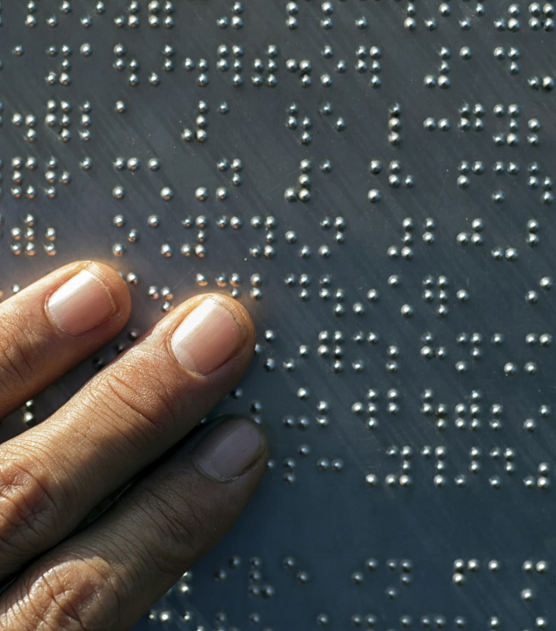
Use Case
Let us consider a use case where a blind person needs to talk to deaf person. Blind doesn’t know sign language & deaf doesn’t know braille
Another case where a normal person needs to talk to a deaf person.

Slide 18
Project Status – 100% Complete
Attained Deliverables
Incomplete Modules
Server – 100% Complete
Hardware – 100% Complete
Front-end – 100% Complete
None

Slide 19
Future Aspects
Developing a fully working prototype and making this project market ready.
The front end of the application will support multiple languages.
The application will be able to translate different languages.
The sign language detection will support live video translation.
A database will be introduced to store communication between two people.
Login/Signup and encryption will be added for more security over internet.
The braille device will have actuators.
The braille device will be wireless.
The braille device will be smaller in size.

Slide 20
Research Papers (Future Aspects)
Hardware
Sign Language Detection
Complete application
Title – Wireless text to braille and braille to text conversion device.
Description – The paper will talk about the construction of the hardware, it’s working and it’s usage.
Title – Sign Language detection through TensorFlow.
Description – The paper will talk about how our sign language translator is working in the server.
Title – Saksham : Communication solution for disabled.
Description – This paper will talk about how we were able to incorporate all the communication methods all together and how the translation is taking place in the applications.

Slide 21
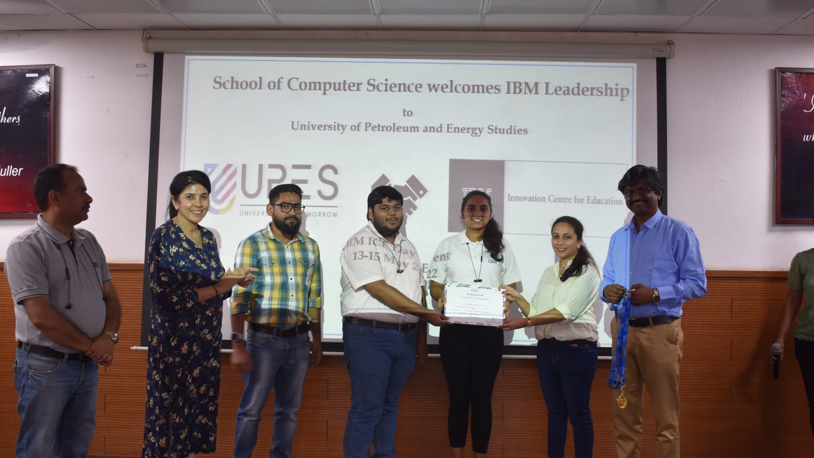
Winner of IBM ICE day Project Presentation Competition

Slide 22
[1] Ankit Ojha, Ayush Pandey, Shubham Maurya, Abhishek Thakur, Dr. Dayananda P 2020. Sign Language to Text and Speech Translation in Real Time Using Convolutional Neural Network [2] Mirza, S. F., & Al-Talabani, A. K. (2021). Efficient Kinect Sensor-based Kurdish Sign Language Recognition Using Echo System Network. [3] Y. Neeraja,D.Susritha Reddy, J.Kalpana, K.Subhasri, D. Lokesh 2021, AN ADVANCED BRAILLE SYSTEM-COMMUNICATION DEVICE FOR BLIND-DEAF PEOPLE [4] Himanshu Gautam, Prerna Gaur 2020, DRISHYAM: Real-Time Text to Braille Conversion and Realization [5] Vadim Popov, Ivan Vovk, Vladimir Gogoryan, Tasnima Sadekova, Mikhail Kudinov 2021. Grad-TTS: A Diffusion Probabilistic Model for Text-to-Speech [6] Prerana Das, Kakali Acharjee, Pranab Das and Vijay Prasad 2015, VOICE RECOGNITION SYSTEM: SPEECH-TO-TEXT [7] World Report on Disability [8] Census of India, 2001 [9] https://censusindia.gov.in/census_and_you/disabled_population.aspx
References

Slide 23
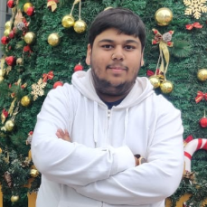
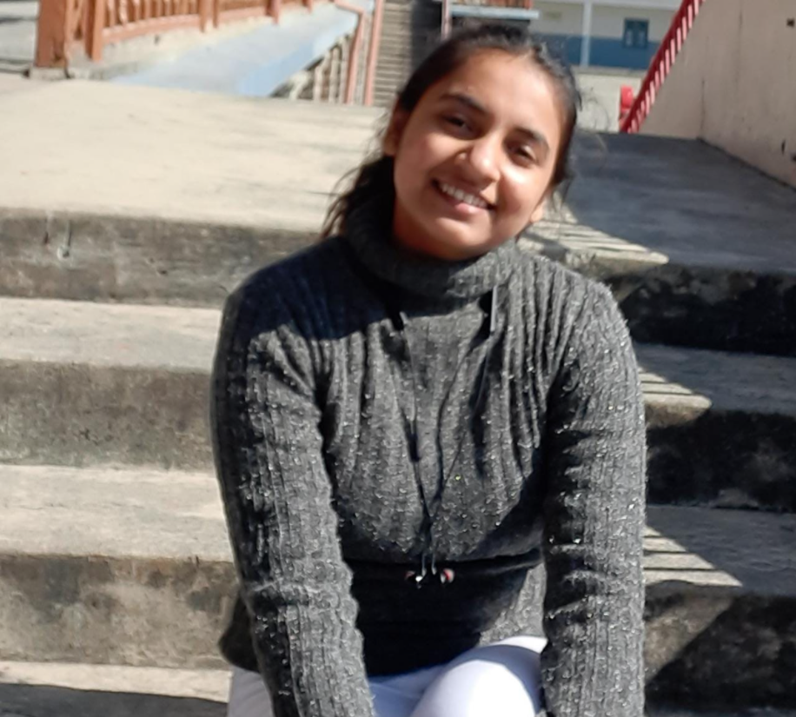
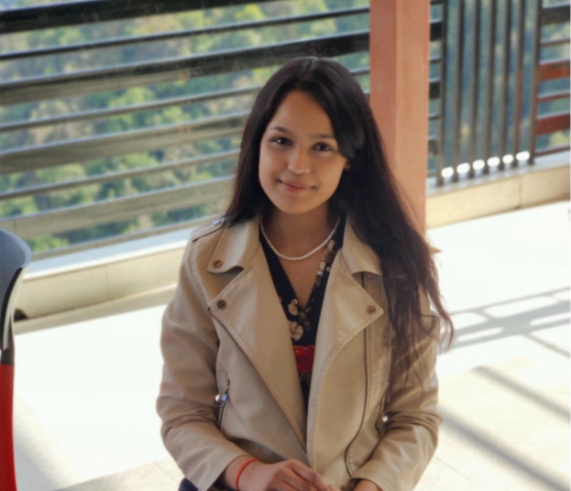
Our team
Utkarsh Gupta
Aradhya Singh
Priyal Gupta
R177219194 500075374@stu.upes.ac.in B. Tech CSE AI&ML B6
R177219200 500075358@stu.upes.ac.in B. Tech CSE AI&ML B6
R177219136 500076110@stu.upes.ac.in B. Tech CSE AI&ML B6

Slide 24
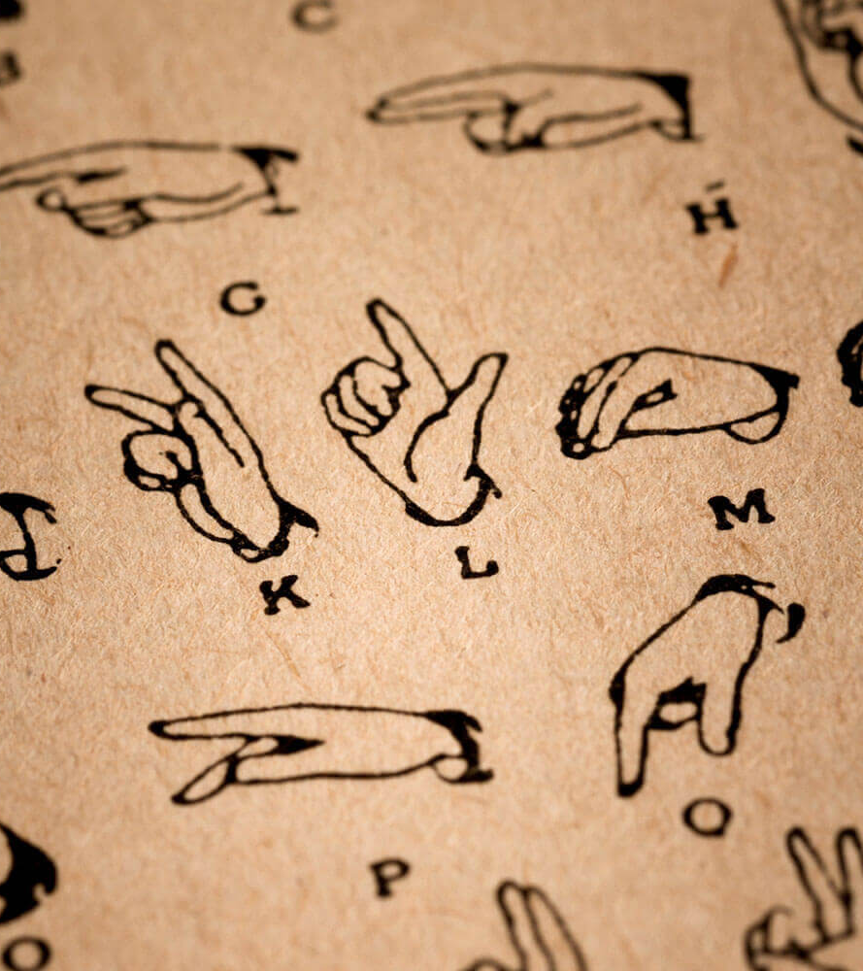
Thank you

